Slide 1
DRUM: Matrix Recovery from Unlabeled Data (with Missing Entries)
Liangzu Peng @ Informs Annual Meeting
October 18, 2023
Innovation in Data Engineering and Science (IDEAS)
https://research.seas.upenn.edu/initiatives/data-science/

Slide 2

The Presentation is Based on …
“Old” work (NeurIPS 2021)
Reborn with a significant revision

Slide 3
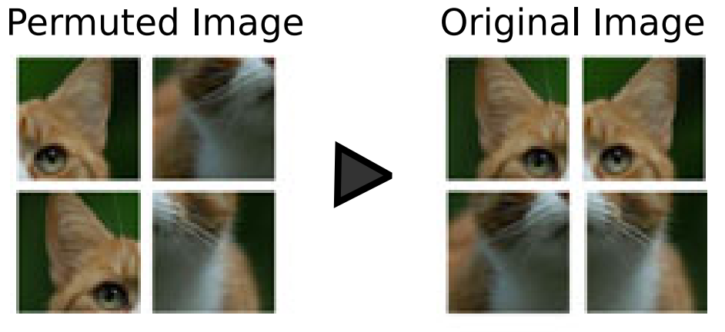
Motivating Example 1
How to recover an image from its shuffled patches?
(Cruz et al.) Visual Permutation Learning (TPAMI 2019)

Slide 4
Motivating Example 2
I am a data collector
I collect data in Philadelphia
Name | Institute
Haixiang Zhang | UC Berkeley
Jikai Jin | Stanford
Mengqi Lou | GeorgiaTech
Xiaopeng Li | Columbia University
Vaidehi Srinivas | Northwestern University
Liangzu Peng | UPenn

Slide 5
Motivating Example 2
I am another data collector
I collect data at the Phoenix Convention Center
Name | Role
Jikai Jin | Speaker 1
Haixiang Zhang | Session Chair
Mengqi Lou | Speaker 2
Vaidehi Srinivas | Speaker 4
Xiaopeng Li | Speaker 3
Liangzu Peng | Speaker 5

Slide 6
Motivating Example 2
I am yet another data collector
I collect data at my hotel
Name | GPA
Liangzu Peng | 2.4
Jikai Jin | 4.0
Mengqi Lou | 4.0
Xiaopeng Li | 4.0
Vaidehi Srinivas | 4.0
Haixiang Zhang | 4.0

Slide 7
Motivating Example 2
I am yet yet another data collector
I collect data in the room (CC-North 222B)
Name | Weight | Height | Race
Vaidehi Srinivas | … | … | …
Jikai Jin | … | … | …
Mengqi Lou | … | … | …
Haixiang Zhang | … | … | …
Liangzu Peng | … | … | …
Xiaopeng Li | … | … | …

Slide 8

Motivating Example 2
Real Scenario (Record Linkage): Government Agencies collect data at different locations and in different order, and have the need to routinely combine datasets from different sources
I want to release the data, and I want preserve privacy
Let me remove the identity information, publish the following data
Role
Speaker 1
Session Chair
Speaker 2
Speaker 4
Speaker 3
Speaker 5
Institute
UC Berkeley
Stanford
GeorgiaTech
Columbia University
Northwestern University
UPenn
GPA
2.4
4.0
4.0
4.0
4.0
4.0
Height, Weight, Race
…
…
…
…
…
…
Question: Can we recover the correspondence information from this unlabeled dataset?

Slide 9
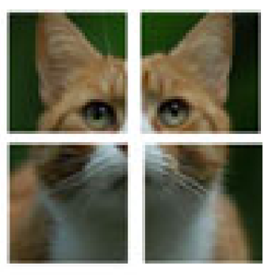
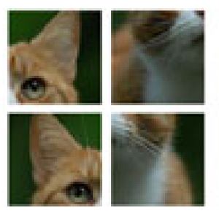
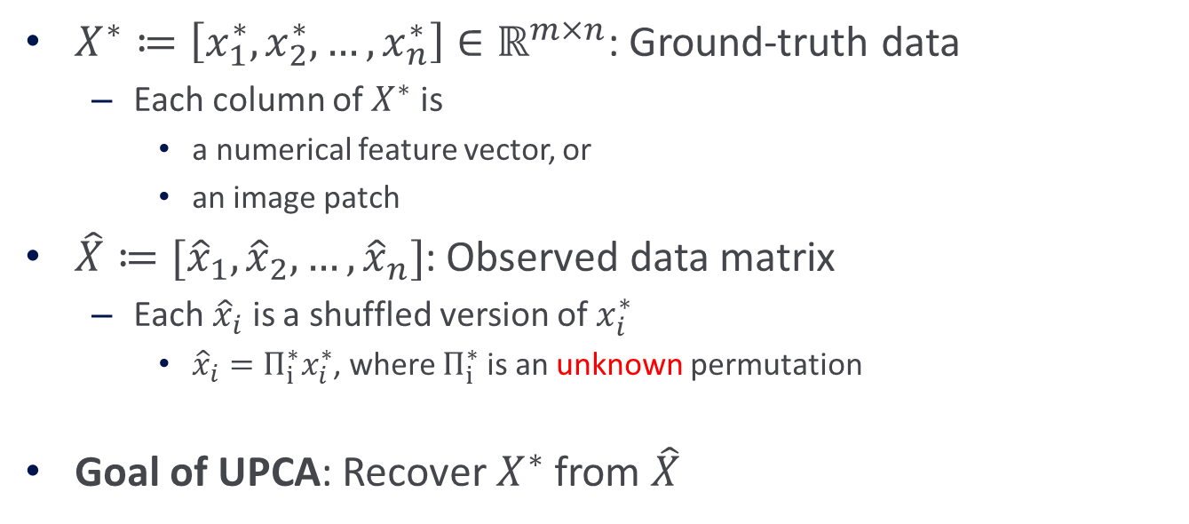
Unlabeled Principal Component Analysis (UPCA)
$X^{∗}≔\left[x_{1}^{∗},x_{2}^{∗},…,x_{n}^{∗}\right]∈ℝ^{m×n}$: Ground-truth data
Each column of $X^{∗}$ is
a numerical feature vector, or
an image patch
$\hat{X}≔[{\hat{x}}_{1},{\hat{x}}_{2},…,{\hat{x}}_{n}]$: Observed data matrix
Each ${\hat{x}}_{i}$ is a shuffled version of $x_{i}^{∗}$
${\hat{x}}_{i}=Π_{i}^{∗}x_{i}^{∗}$, where $Π_{i}^{∗}$ is an unknown permutation
Goal of UPCA: Recover $X^{∗}$ from $\hat{X}$

Slide 10
Connection to Other Matrix Recovery Problems
Matrix recovery with …
linear measurements (matrix sensing)
missing entries (matrix completion)
outliers (outlier-robust PCA)
unlabeled data (UPCA)

Slide 11
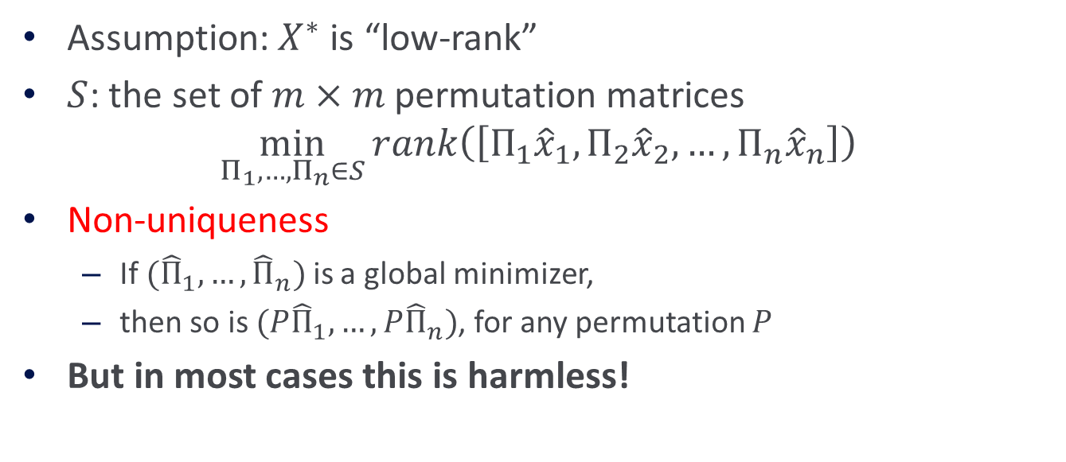
Formulation
Assumption: $X^{∗}$ is “low-rank”
$S$: the set of $m×m$ permutation matrices
$$\min_{Π_{1},…,Π_{n}∈S}{rank\left(\left[Π_{1}{\hat{x}}_{1},Π_{2}{\hat{x}}_{2},…,Π_{n}{\hat{x}}_{n}\right]\right)}$$
Non-uniqueness
If $({\hat{Π}}_{1},…,{\hat{Π}}_{n})$ is a global minimizer,
then so is $(P{\hat{Π}}_{1},…,P{\hat{Π}}_{n})$, for any permutation $P$
But in most cases this is harmless!
Role
Speaker 1
Session Chair
Speaker 2
Speaker 4
Speaker 3
Speaker 5
GPA
2.4
4.0
4.0
4.0
4.0
4.0

Slide 12
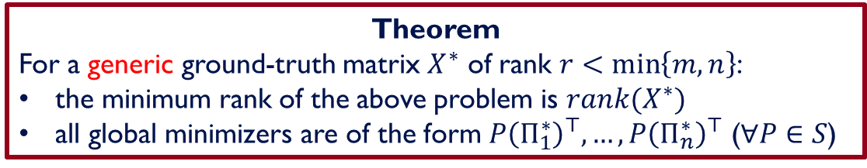
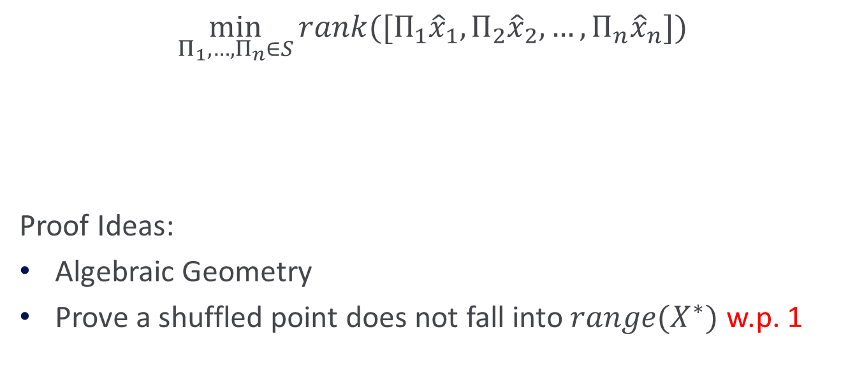
Characterization of Global Minimizers
$$\min_{Π_{1},…,Π_{n}∈S}{rank([Π_{1}{\hat{x}}_{1},Π_{2}{\hat{x}}_{2},…,Π_{n}{\hat{x}}_{n}])}$$
Proof Ideas:
Algebraic Geometry
Prove a shuffled point does not fall into $range(X^{∗})$ w.p. 1
Theorem
For a generic ground-truth matrix $X^{∗}$ of rank $r<\min\left\{m,n\right\}$:
the minimum rank of the above problem is $rank(X^{∗})$
all global minimizers are of the form $P{\left(Π_{1}^{∗}\right)}^{⊤},…,P{\left(Π_{n}^{∗}\right)}^{⊤}$ ($∀P∈S$)

Slide 13
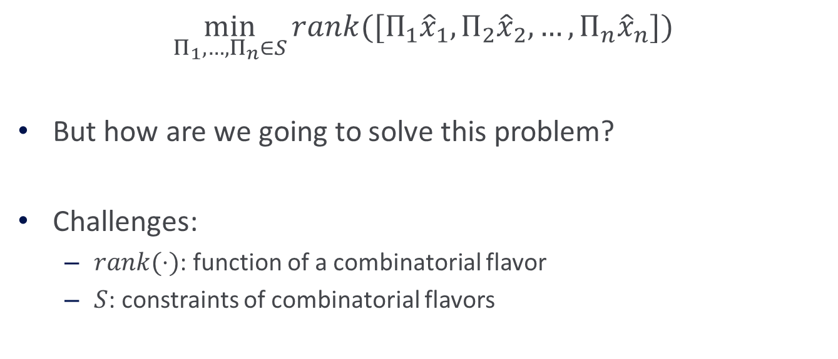
Computational Challenges
$$\min_{Π_{1},…,Π_{n}∈S}{rank([Π_{1}{\hat{x}}_{1},Π_{2}{\hat{x}}_{2},…,Π_{n}{\hat{x}}_{n}])}$$
But how are we going to solve this problem?
Challenges:
$rank(⋅)$: function of a combinatorial flavor
$S$: constraints of combinatorial flavors

Slide 14
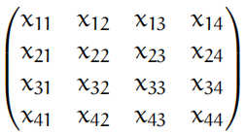
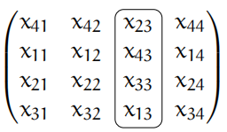

Dominant Permutation Assumption
Assume most columns are shuffled by the same permutation
Example
Ground-truth $X^{∗}$ Observed Data $\hat{X}$

Slide 15
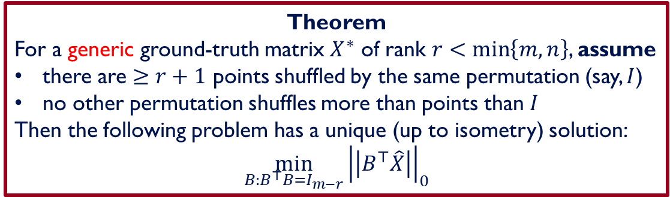

Dominant Permutation Assumption
Theorem
For a generic ground-truth matrix $X^{∗}$ of rank $r<\min\left\{m,n\right\}$, assume
there are $≥r+1$ points shuffled by the same permutation (say, $I$)
no other permutation shuffles more than points than $I$
Then the following problem has a unique (up to isometry) solution:
$$\min_{B:B^{⊤}B=I_{m−r}}{{\left|\left|B^{⊤}\hat{X}\right|\right|}_{0}}$$
If a column $x$ of $X^{∗}$ is not shuffled, then $x^{⊤}B^{∗}=0$
$B^{∗}$: an orthonormal basis of the orthogonal complement of $X^{∗}$

Slide 16
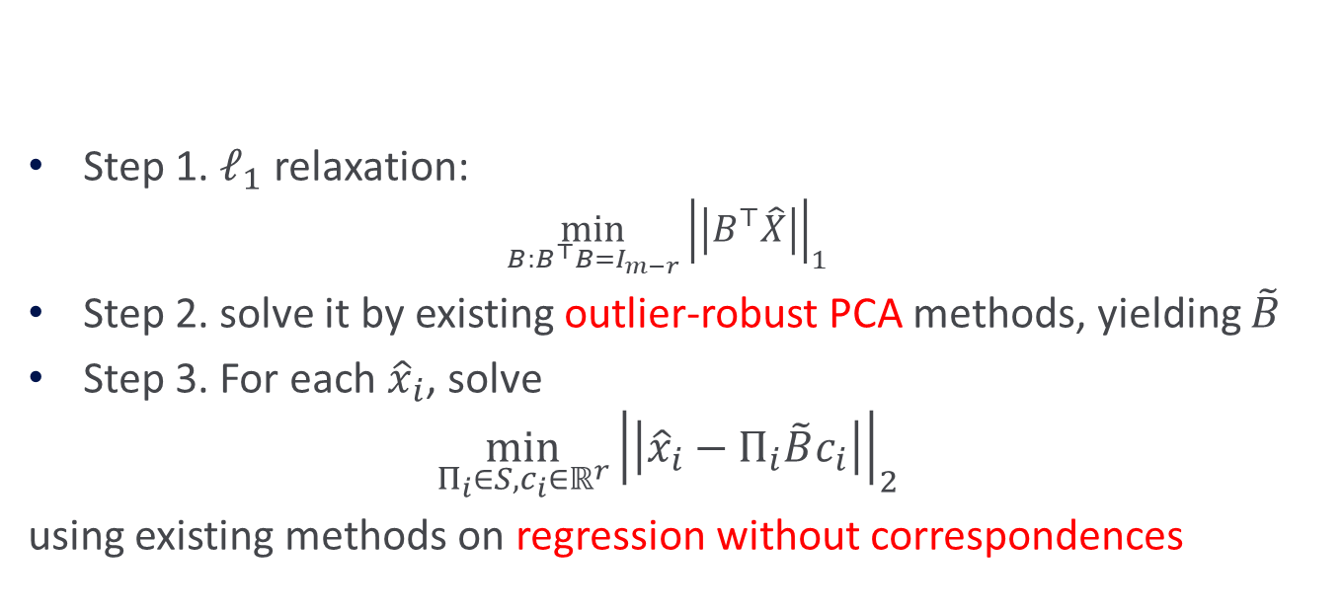
Algorithm
$$\min_{B:B^{⊤}B=I_{m−r}}{{\left|\left|B^{⊤}\hat{X}\right|\right|}_{0}}$$
Step 1. $ℓ_{1}$ relaxation:
$$\min_{B:B^{⊤}B=I_{m−r}}{{\left|\left|B^{⊤}\hat{X}\right|\right|}_{1}}$$
Step 2. solve it by existing outlier-robust PCA methods, yielding $\tilde{B}$
Step 3. For each ${\hat{x}}_{i}$, solve
$$\min_{Π_{i}∈S,c_{i}∈ℝ^{r}}{{\left|\left|{\hat{x}}_{i}−Π_{i}\tilde{B}c_{i}\right|\right|}_{2}}$$
using existing methods on regression without correspondences

Slide 17
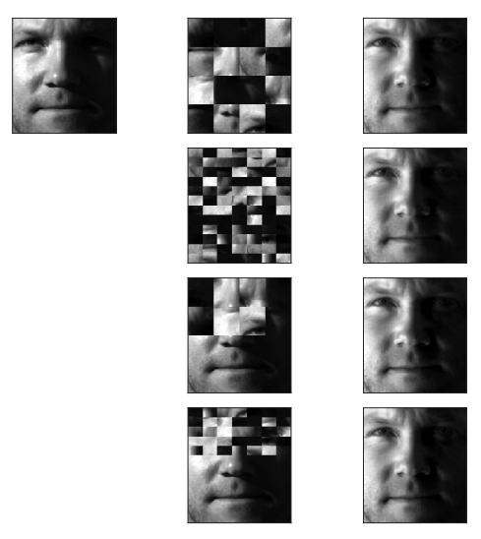
Experiments on the extended Yale B dataset
Column 1:
Original image
Column 2:
Shuffled image (input)
Column 3:
Recovered image (output)

Slide 18
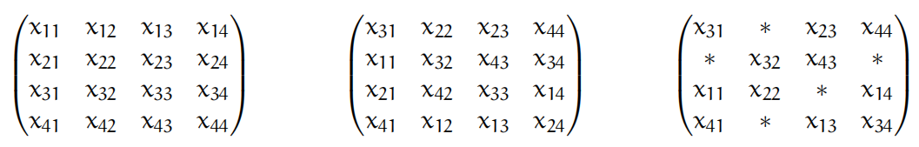
Extension: Unlabeled Matrix Completion
Ground-Truth UPCA data UMC data

Slide 19

Thank you for your attention

